Slide 1
EMPLOYEE DATA ANALYSIS USING EXCEL
STUDENT NAME : BLESSY.M REGISTER NUMBER: 422200472 NM ID: 491C40016E2C11087EE4D029523CB605 DEPARTMENT: B.COM(ISM) COLLEGE NAME VALLIAMMAL COLLEGE FOR WOMEN

Slide 2
PROJECT TITTLE
EMPLOYEE PERFORMANCE ANALYSIS USING EXCEL

Slide 3
AGENDA
•PROBLEM STATEMENT • PROJECT OVERVIEW •END USERS •OUR SOLUTION AND PROPOSITION •DATA DESCRIPTION •MODELINO APPROACH •RESULTS AND DISCUSSION •CONCLUSION

Slide 4
PROBLEM STATEMENT
ANALYSING EMPLOYEE PERFORMANCE ENABLES ORGANIZATIONS TO OPTIMIZE PRODUCTIVITY BY ENSURING THAT EMPLOYEES ARE WORKING EFFICIENTLY AND EFFECTIVELY TOWARDS THEIR GOALS.

Slide 5
PROJECT OVERVIEW
•ANALYZE THE SALARY OF THE EMPLOYEE BY CONSIDERING VARIOUS FACTORS LIKE GENDER, EMPLOYEE ID, START DATE, EMPLOYEE TYPE, DEPARTMENT ETC. DIFFERENT CATEGORIES OF EMPLOYEE SALARY LIKE VERY HIGH, HIGH. MEDIUM AND LOW.

Slide 6
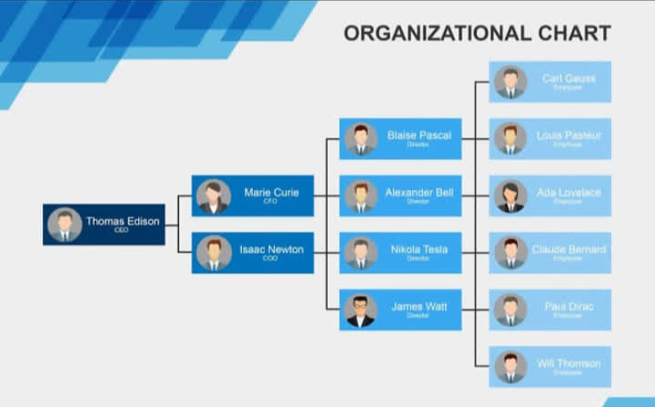
Who are the end users?

Slide 7
OUR SOLUTION AND IT’S VALUE PROPOSITION
•CONDITIONAL FORMATTING MISSING •FILTER – REMOVE •FORMULA – PERFORMANCE LEVEL •PIVOT SUMMARY
GRAPH-DATA VISUALIZATION

Slide 8
DATASET DESCRIPTION
•EMPLOYEE DATASET -EDUNET DASHBOARD •26-FEATURES •9-FEATURES •EMPLOYEE ID NUMERICAL VALUE •NAME-TEXT •GENDER TEXT •SALARY-NUMERICAL VALUE •START DATE NUMERICAL VALUE

Slide 9
THE “WOW” IN OUR SOLUTION • WE USE THIS FORMULA • ifs(z8>=5,”very high”,Z8>=4,”high”,z8>=3,”med”, true”, low”)

Slide 10
DATA COLLECTION •NAN MUDHAIVAN • EDUNET DASHBOARD FEATURE SELECTION •26 FEATURES •9 FEATURES DATA CLEANING •COLOUR BLANK VALUES •FILTER REMOVE BLANK VALUES
MODELING

Slide 11
Salary level •Very high •High •Medium •Low Pivot table •Employee id •Name •Gender •Salary •Salary level •Start date •Employee type

Slide 12
Employee id Name Gender Salary Salary level Start date Employee type Data visualization
CHART

Slide 13
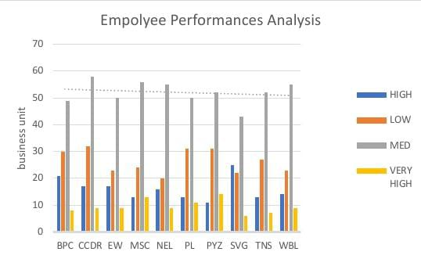
RESULT

Slide 14
While comparing The salary level Of the employee, the employees are getting Their salary According to Their Employee type and start date.
CONCLUSION

